Slide 1
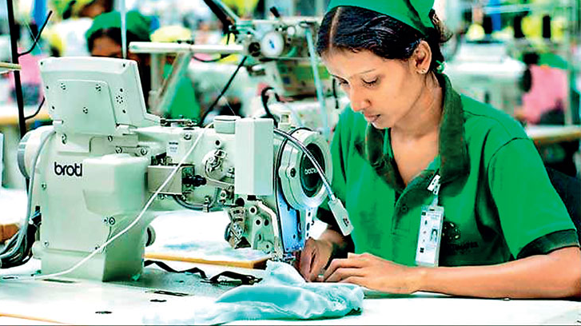

Sumithra Garments (Pvt) Ltd GROUP 02

Slide 2

Group Members
Ashan Lakshitha s14880
Darshana Rupasinghe s15075
Dinuka Dulanji s15039
Dineshika Madhushani s15061
Eranga Edirisinghe s15041
Prasad Sankalpa s14866
Sudam Ranasinghe s14855
Sasindu Chanaka Piyumal s14851
Teena Senanayake s15107
Thaveesha Weerakoon s15012

Slide 3
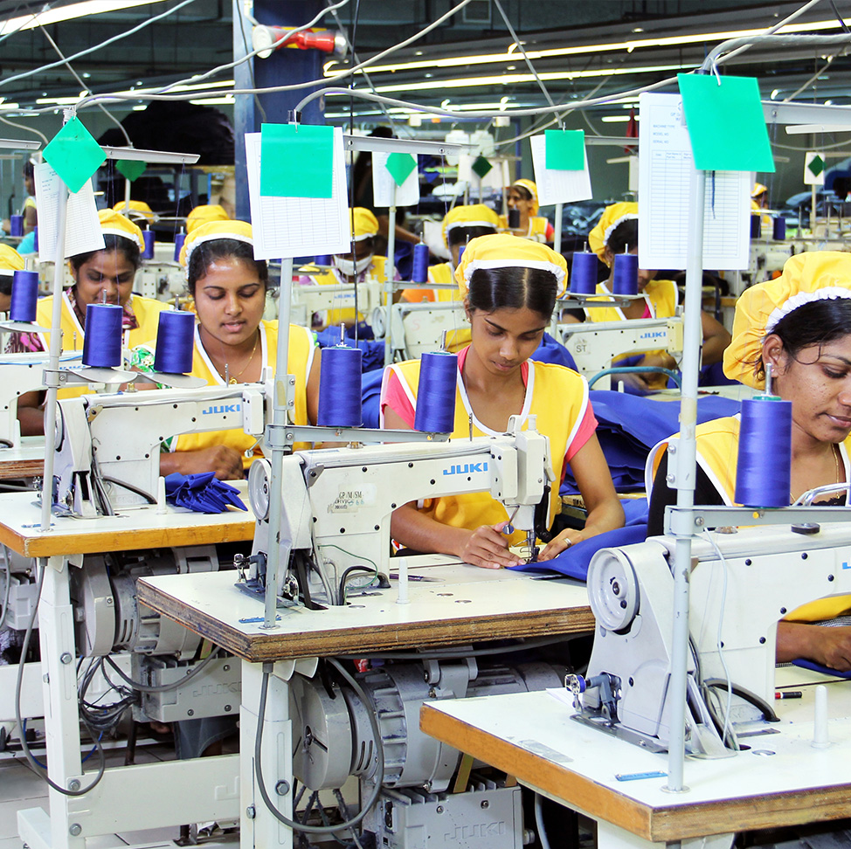
Business Process
Design
Patten Making
Fit Sample And Production Patten Making
Marker Making
Fabric Spreading And Cutting

Slide 4
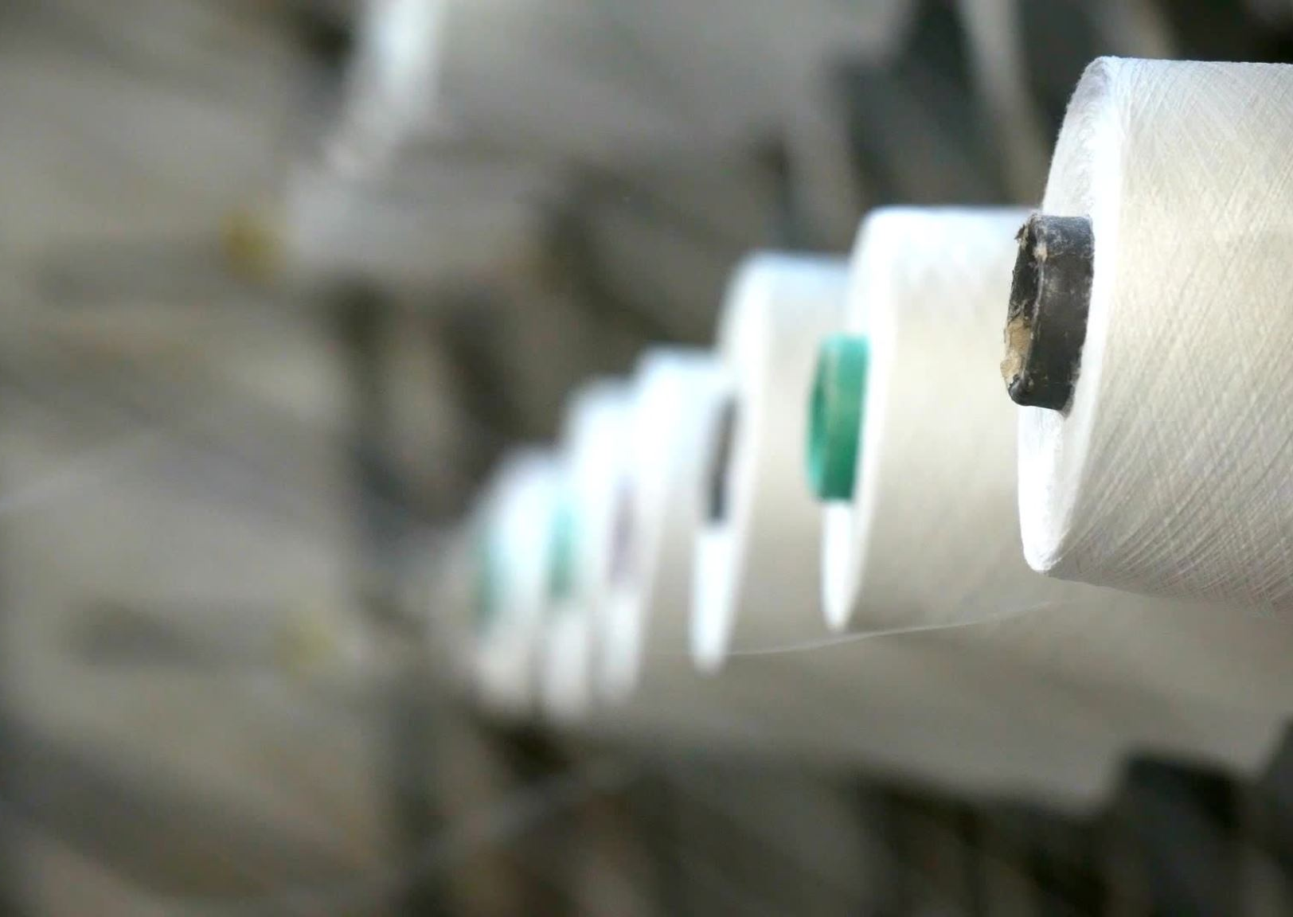
Cutting parts sorting or bunding
Sewing
Quality Control
Pressing and Finishing
Final Quality Control
Packing and shipment.

Slide 5

Information flow
Information Need: Production Schedule
Source: The production department generates the production schedule based on customer orders and inventory levels.
Collection: The production team collects information from the sales department regarding customer orders, delivery dates, and quantities.
Flow: The production schedule is then shared with the procurement department to ensure the availability of raw materials and with the floor managers to plan the production lines accordingly.
This demonstrate how different departments and functions within Sumithra Garments gather and utilize information to ensure smooth operations, effective decision-making, and customer satisfaction.

Slide 6
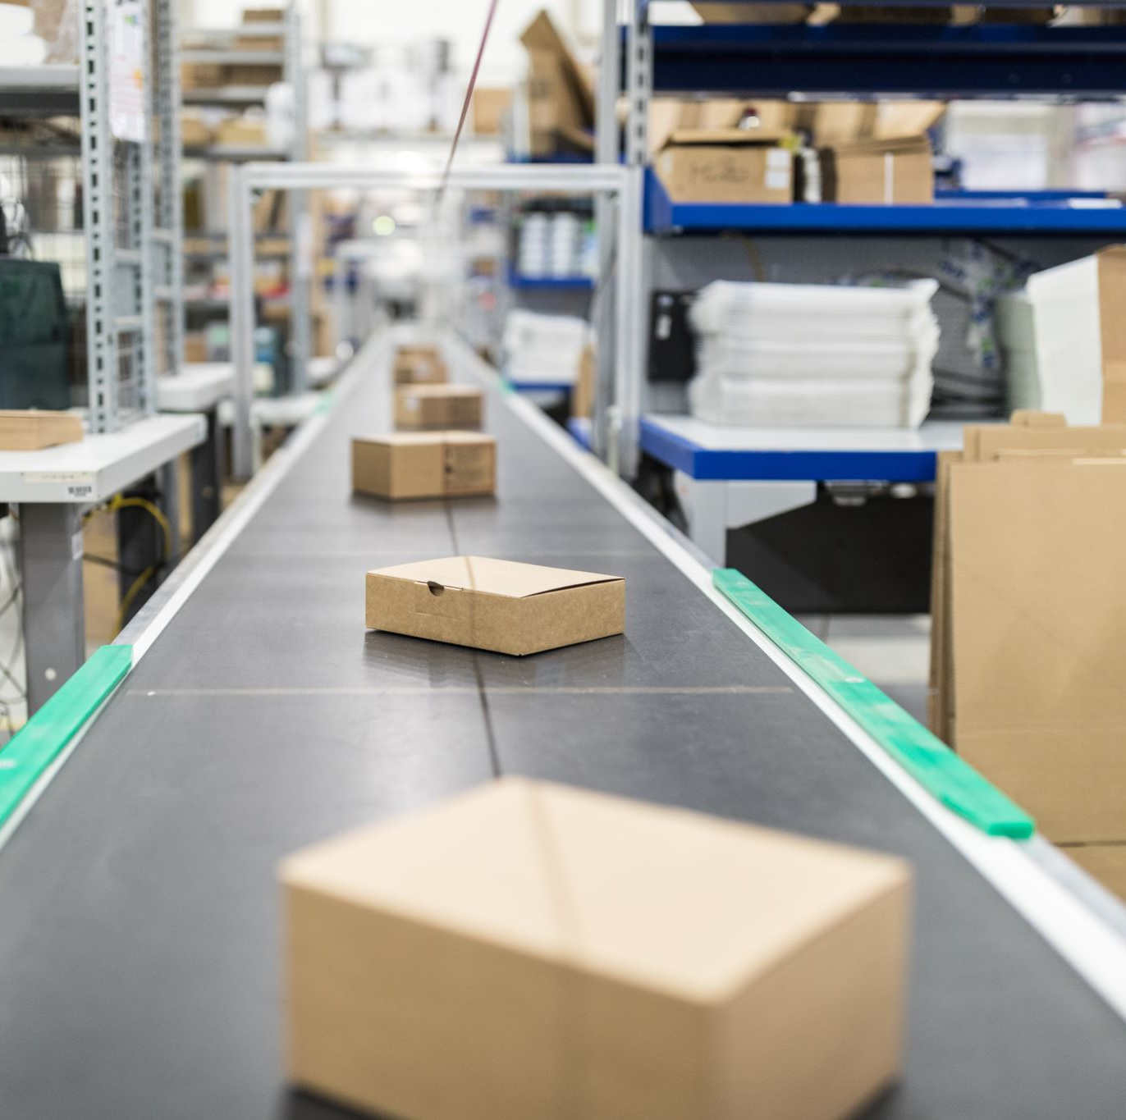
Information Need: Inventory Levels
Source: The inventory management system tracks the quantity and location of raw materials and finished garments.
Collection: Data is collected through barcode scanning or manual entry when raw materials are received or garments are produced.
Flow: The inventory data is shared with the procurement team for reordering raw materials, with the production team to plan production based on available stock, and with the sales team to provide accurate delivery timelines to customers.

Slide 7
Information Need: Quality Control
Source: The quality control department conducts inspections and tests on raw materials and finished garments.
Collection: Inspectors collect data on quality parameters, such as fabric strength or stitching defects, through manual inspections or using measurement devices.
Flow: Quality control reports are shared with the production team for rectification, with the procurement team to address supplier issues, and with the sales team to ensure only quality products are shipped to customers.

Slide 8

Information Need: Sales Analysis
Source: Sales data is collected from customer orders, invoices, and sales reports.
Collection: Sales representatives enter orders into the sales system, and invoices are generated automatically.
Flow: Sales data is analyzed by the sales team to identify trends, demand patterns, and customer preferences. This information is shared with the marketing team for targeted campaigns, with the production team for demand forecasting, and with the finance team for revenue analysis.

Slide 9

Information Need: Shipping and Logistics
Source: Shipping and logistics information is obtained from shipping carriers, transportation partners, and order details.
Collection: Shipping details, such as tracking numbers and delivery status, are collected from carrier systems or transportation partners. Order details are gathered from the sales system.
Flow: The shipping and logistics information is shared with the sales team to provide updates to customers, with the customer service team for addressing delivery inquiries, and with the finance team for order fulfillment and revenue recognition.

Slide 10

IT infrastructure

Slide 11

Servers
Mail Server
Database Server
Web Server
Active Directory (DNS) Server
WSUS Server
Virus Guard Server

Slide 12
Mail Server

Slide 13
Network and Security
FW
internet
Head office LAN
Mesh network topology:
Firewall for LAN Security:
Protects against unauthorized access
Monitors and controls network traffic
Static IP for LAN identification:
Unique addresses for each device
IPSEC protocol for communication within the network Firewall:
Encrypted and authenticated data transmission
RTD Device for Firewall Failover:
Ensures uninterrupted network operation
VLAN for separate section (ex: HR)
FW
FW
S.W. LAN
S.W. LAN
FW
S.W. LAN
S.W. LAN
FW

Slide 14
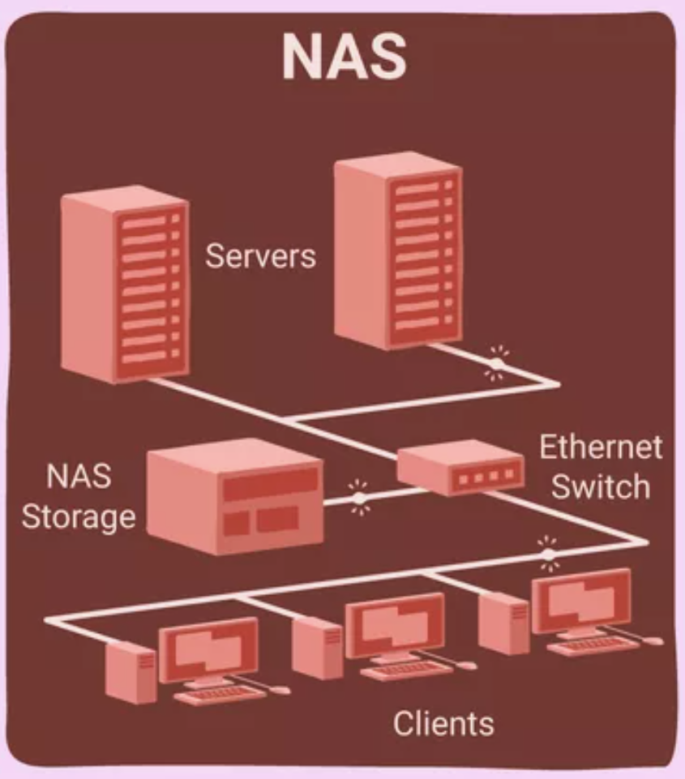
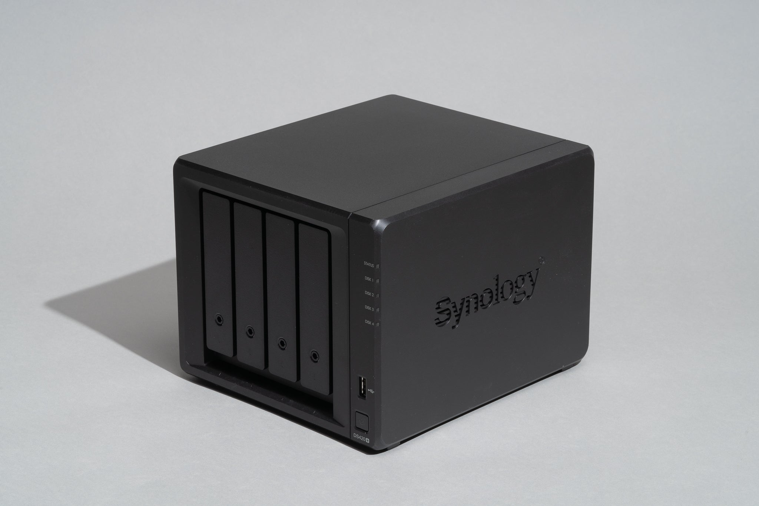
Network Attached Storage - NAS
Dedicated file storage device connected to a network for centralized data storage and file sharing.
Eliminates multiple local storage devices for simplicity.
Automated backup and recovery solution
NAS work as a Disaster Recovery plan.

Slide 15

Suggestions for Improvements
Make respect a cornerstone.
Create clear company values.
Generate positive improvements for the community.
State goals explicitly.
Establish lines of communication.
Encourage employees to voice out their opinions.

Slide 16

Suggestions for Improvements In IT infrastructure
Switching to a cloud based Active directory. Ex: Microsoft Azure Active Directory (Azure AD)
Purchasing an online cloud-based mail server provided from a reputed company like Microsoft instead of the on premises Zimbra technology.
Using a reputed ERP system instead of the company founded APMAS ERP. Ex: SAP
Purchasing a planning system.

Slide 17

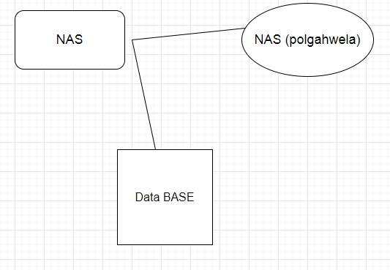
Back Up Plan
During day time data in the data base is backup to the NAS in the server room(Headquarters).
.At the nighttime data from NAS at headquarters is given to NAS at Polgahwela.
Every Friday manually backup was taken from the Database and write them in to DVDs.
The DVD s were kept to 3 to 4 months disposed.

Slide 18

VPN
Using VPN SSL was created (Secure Sockets Layer virtual private network)in the fire wall.
User can create their own exe file to connect with SSL.
When the exe file is executed, firewall create a tunnel to access the VAN( value-added network).

Slide 19

IT policy
General Policy
User have no admin privileges.
Password for the pc can be trail only for three times. Other wise it will be locked.
Default password is given, and the user should change it accordingly.
When the user resigns the all the credentials will be removed from the database.

Slide 20

IT POLICY
Email Policy
Users are not allowed to click scam emails.
Users are recommended to be professional when sending mails.
Sharing Personal information is not allowed via company email.

Slide 21
IT Policy
USER POLICY
Users are not allowed to use internet for private usage.
Streaming in social media is not allowed.
Site visited by users are being monitored.
Users are not allowed to store personal information in the company machine.
If any part of the pc was damaged due to carelessness of the user it will be charged from them.

